Slide 1
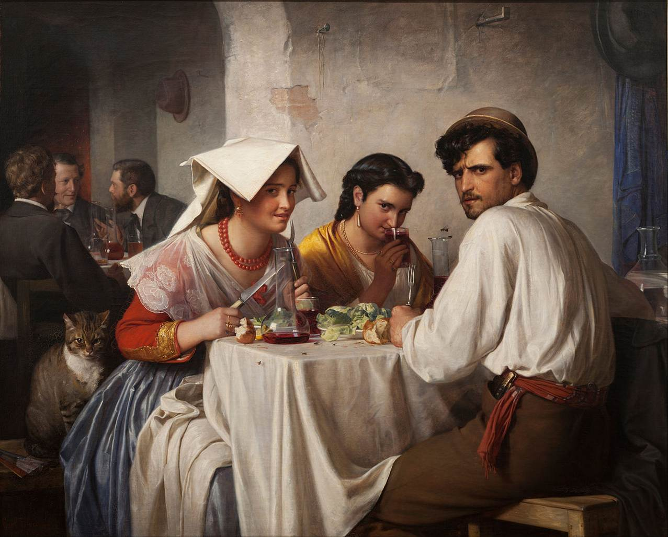


Slide 2
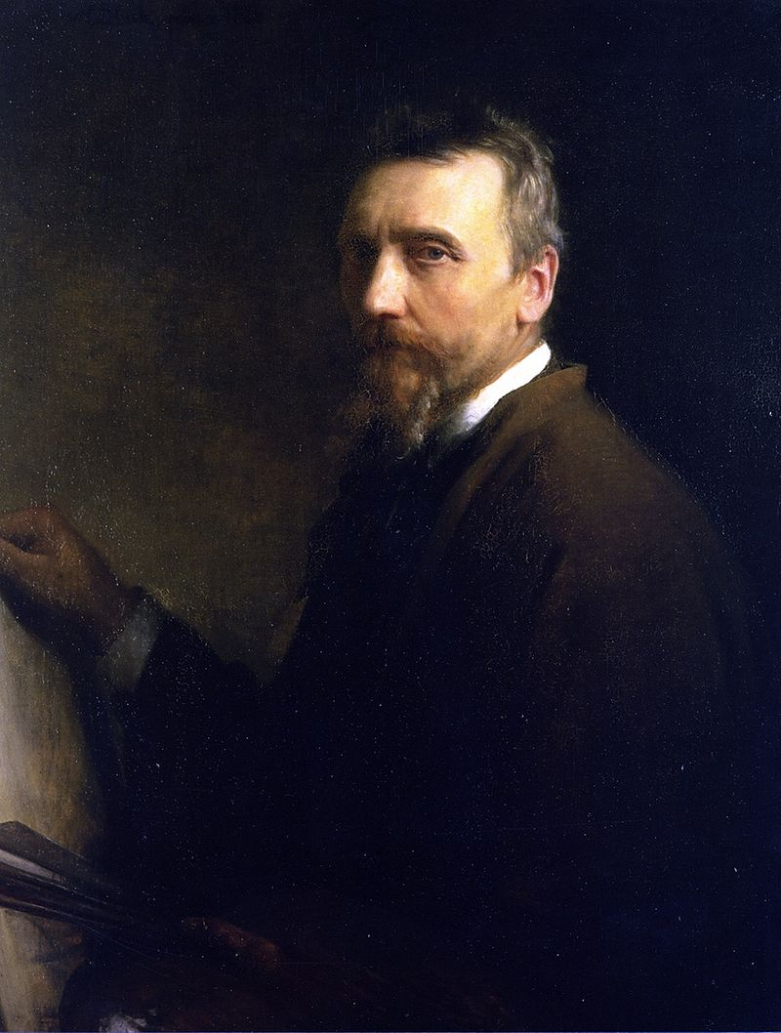
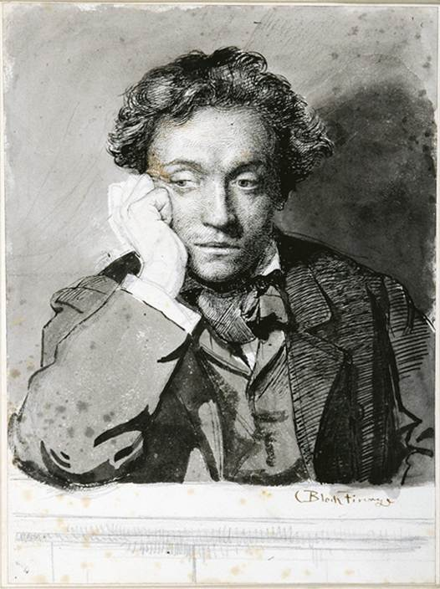
Carl Heinrich Bloch
(1834-1890)
Danish Painter
Self Portrait
Self Portrait
Notes:
Self Portrait

Slide 3
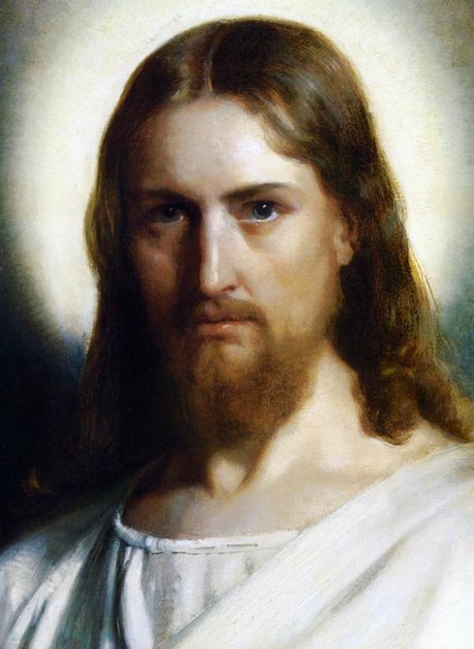
Christ

Slide 4
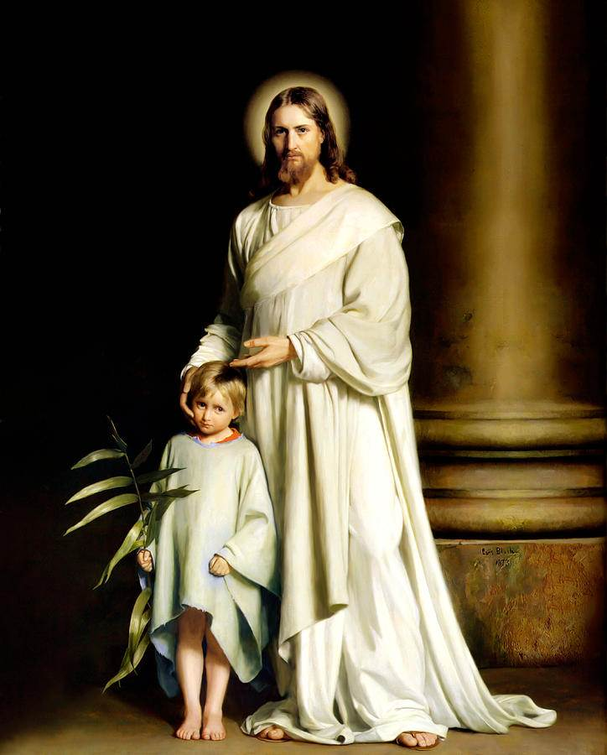
Christ
And The Young Child

Slide 5
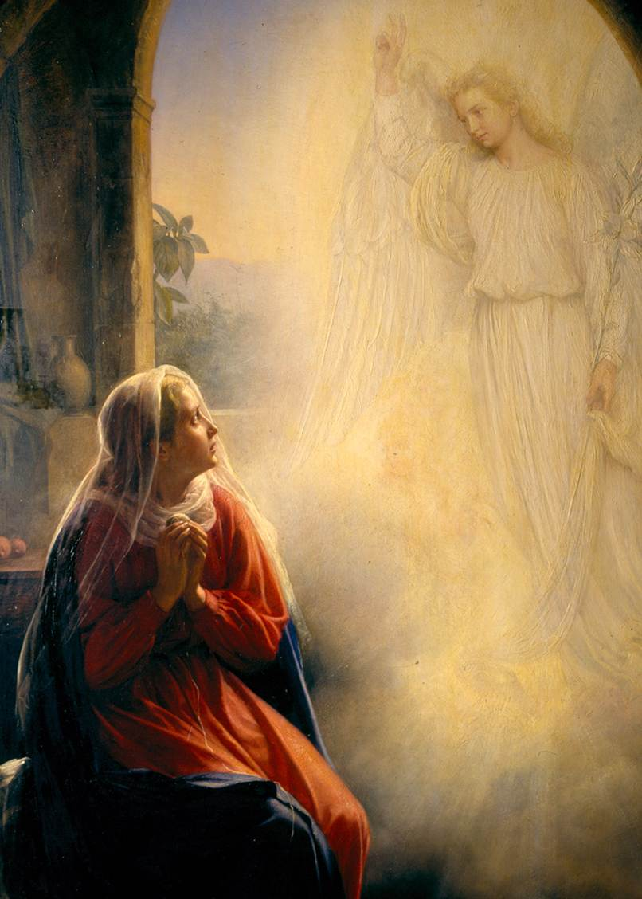
The Annunciation
눅1:28

Slide 6
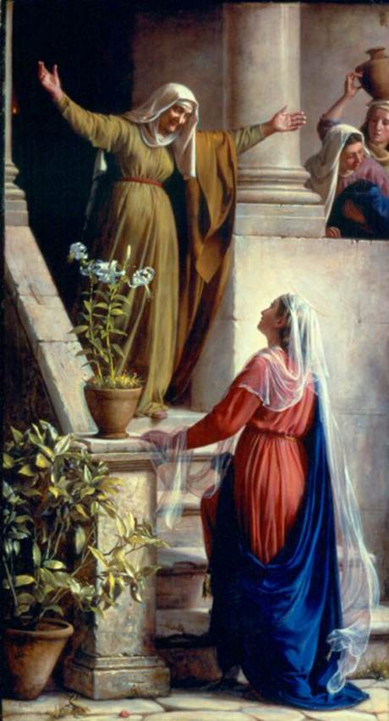
Mary and Elizabets
눅1:40

Slide 7
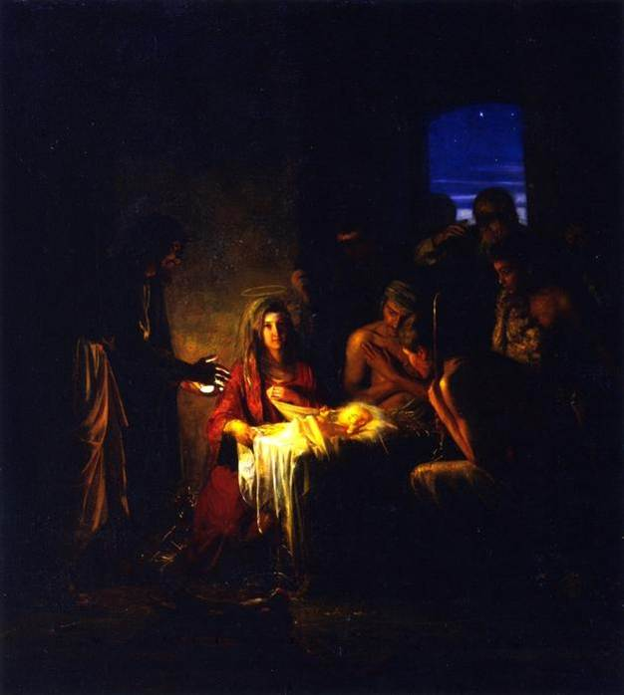
The Birth of Christ 눅2:7

Slide 8
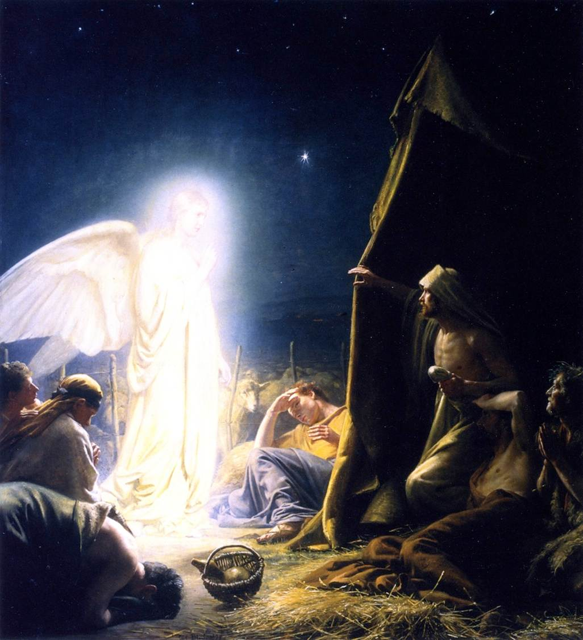
The Shepherds and the Angel
Notes:
The Shepherds and the Angel

Slide 9
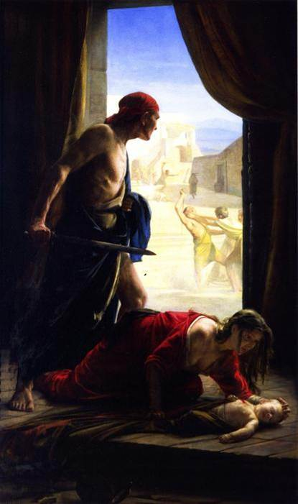
Massacre of the Innocents 마2:16

Slide 10
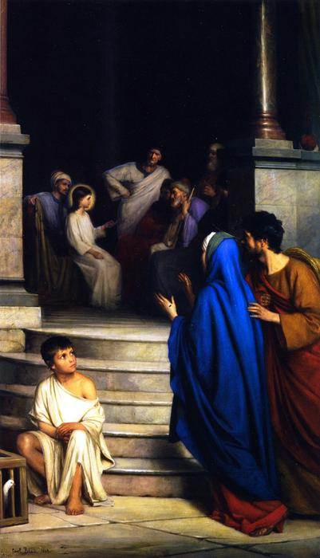
Twelve year old Jesus
in the Temple
눅2:46

Slide 11
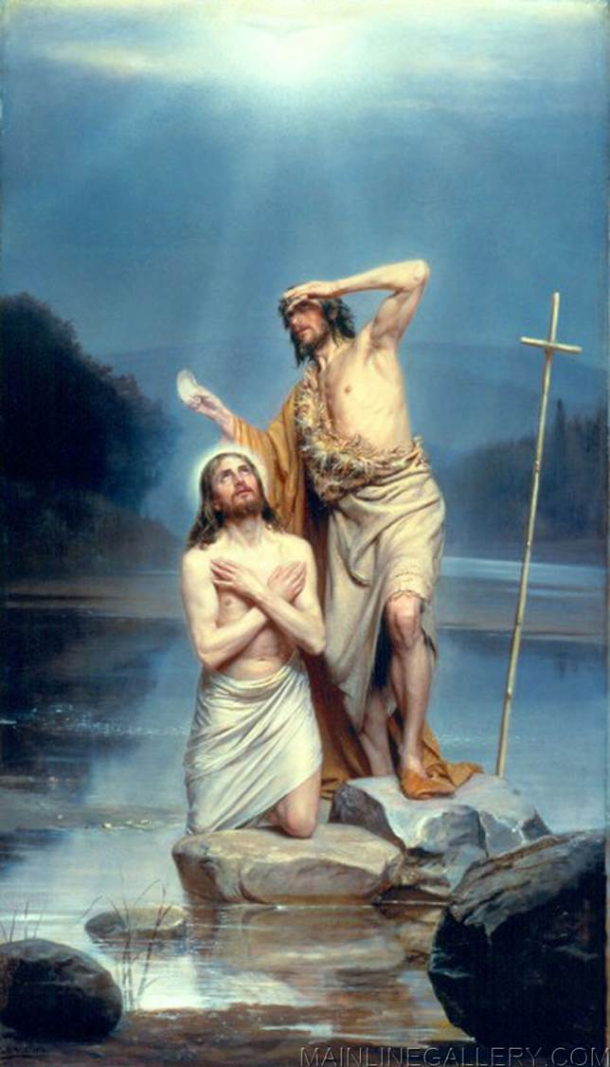
Christ Being Baptized
막1:9

Slide 12
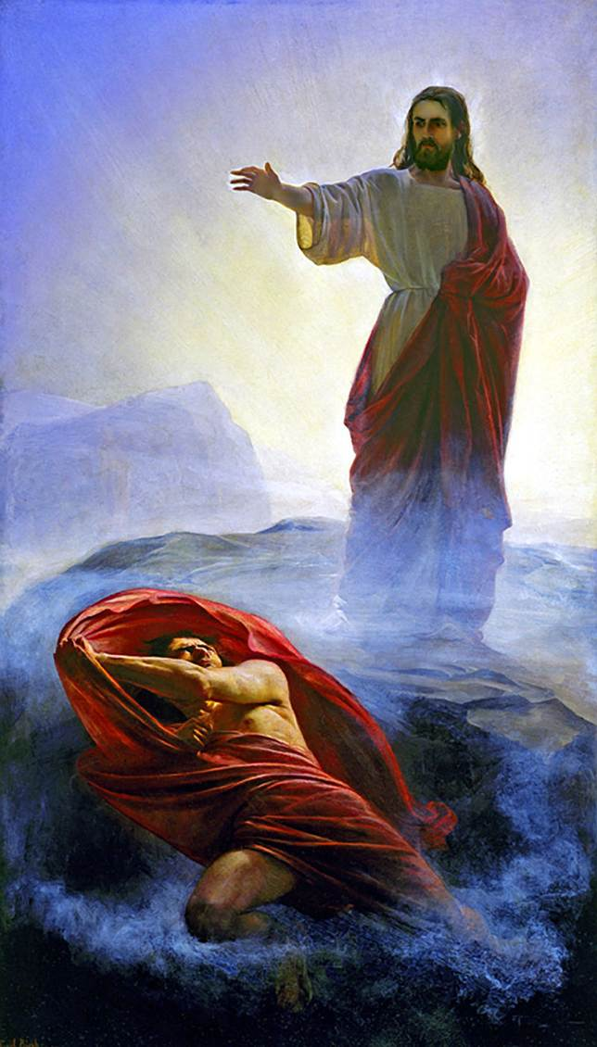
Jesus Tempted by the Devil
마4:1
Notes:
Jesus Tempted by the Devil 마4:1

Slide 13
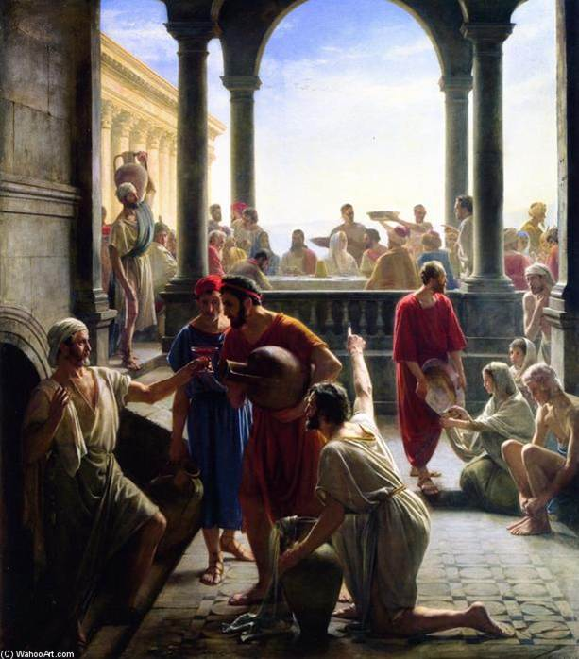
Wedding at Cana 요2:1

Slide 14
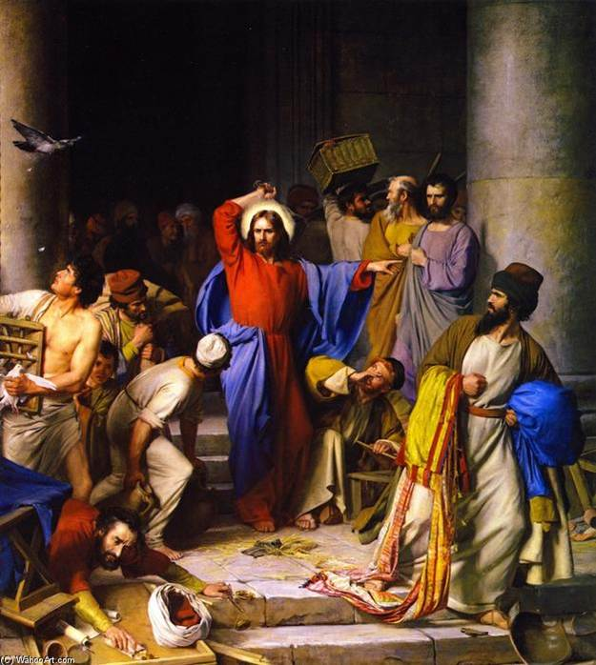
Cleansing
of the Temple
요2:13

Slide 15
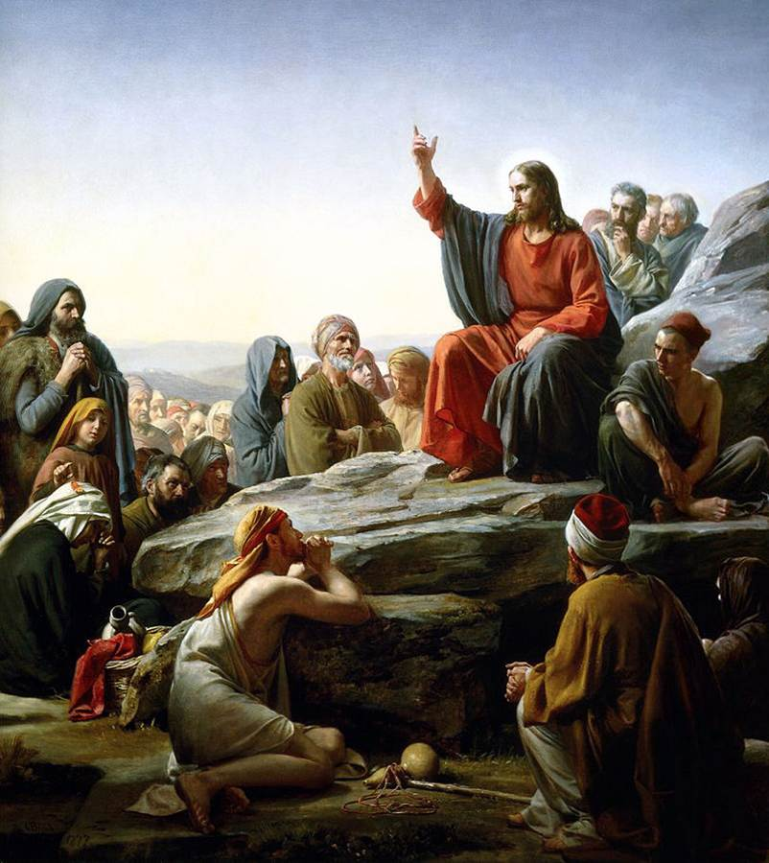
The Sermon
on the Mount
마5:2
Notes:
The Sermon on the Mount 마5:2

Slide 16
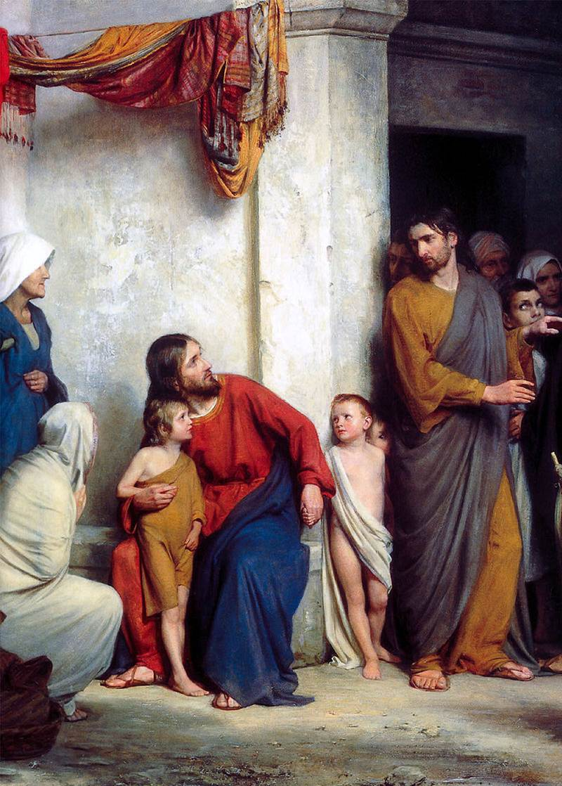
Suffer the Children
마19:13

Slide 17
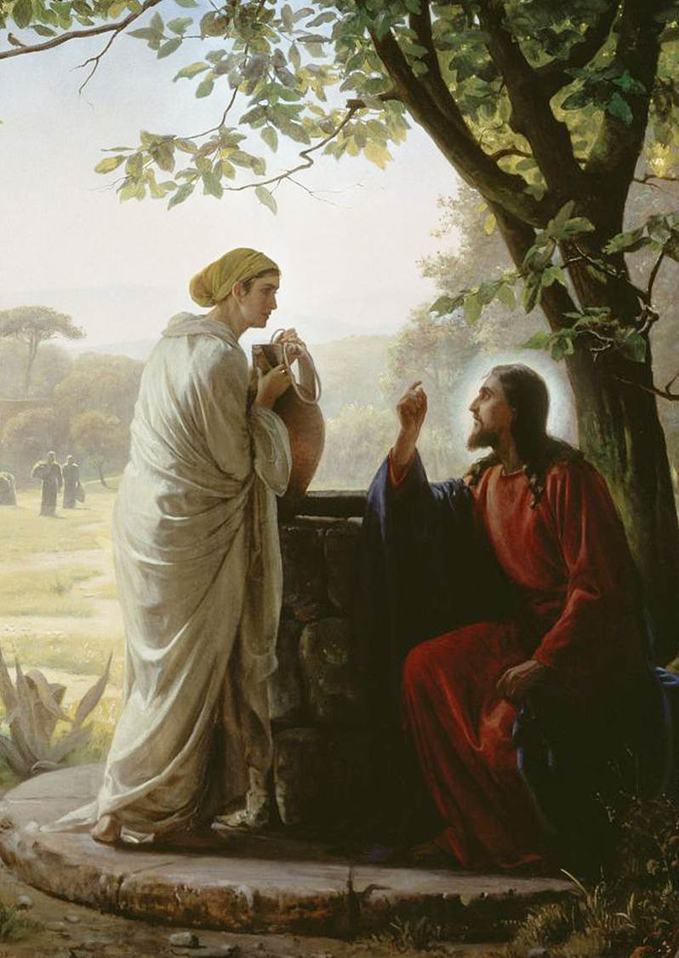
The Samaritan Woman
at the Well
요4:7

Slide 18
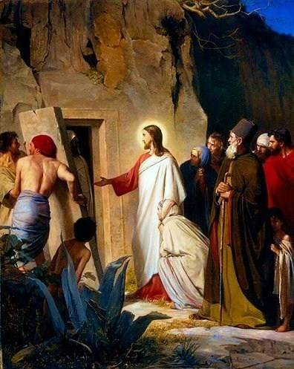
Raising of Lazarus
요11:43

Slide 19
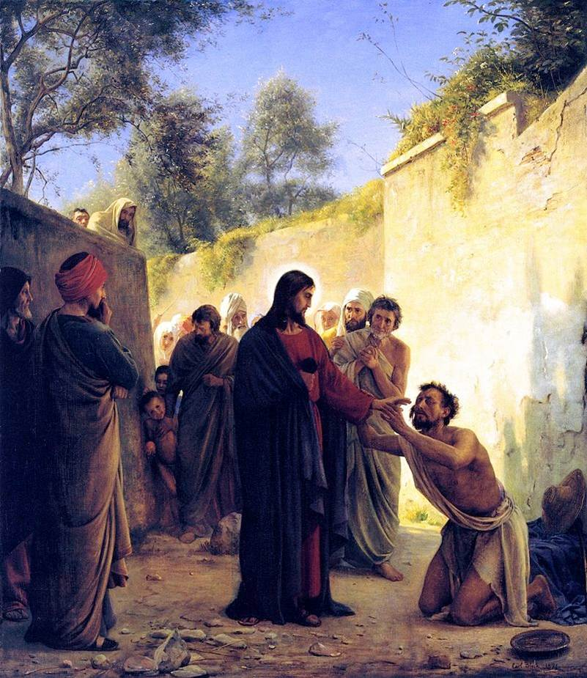
Healing
of the Blind Man
요9:6

Slide 20
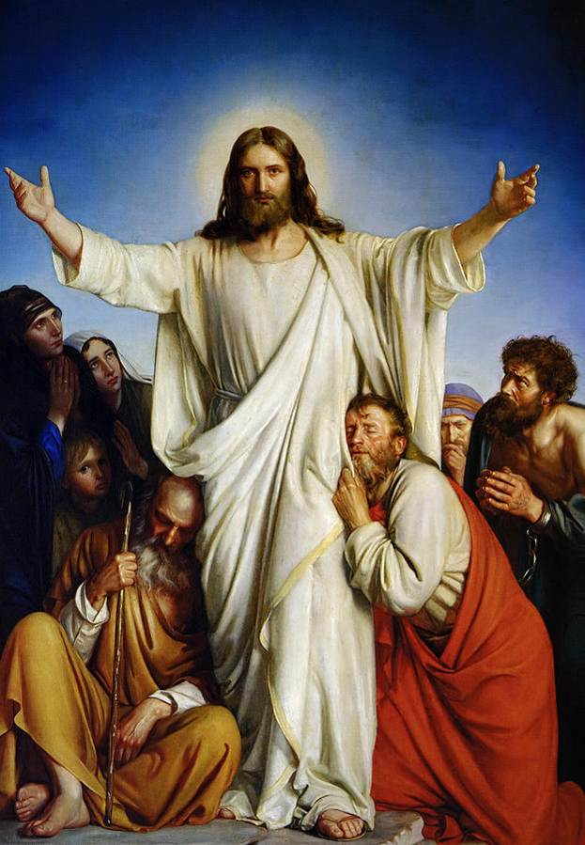
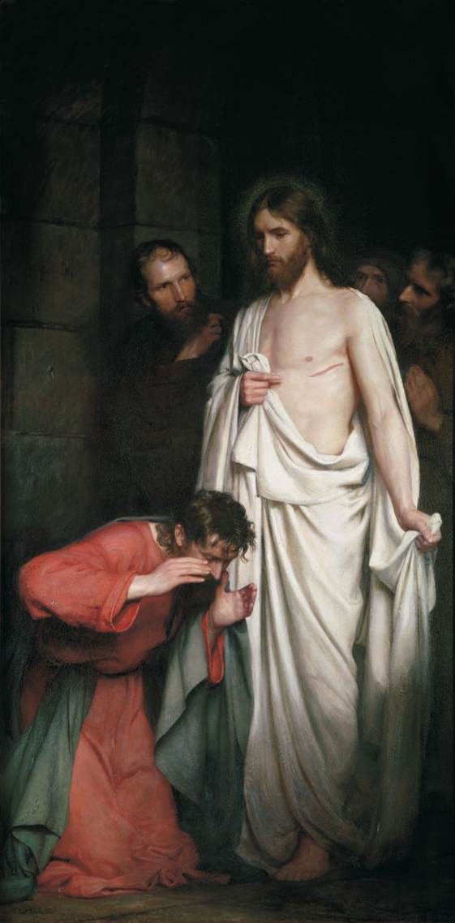
Consolator at the Chapel

Slide 21
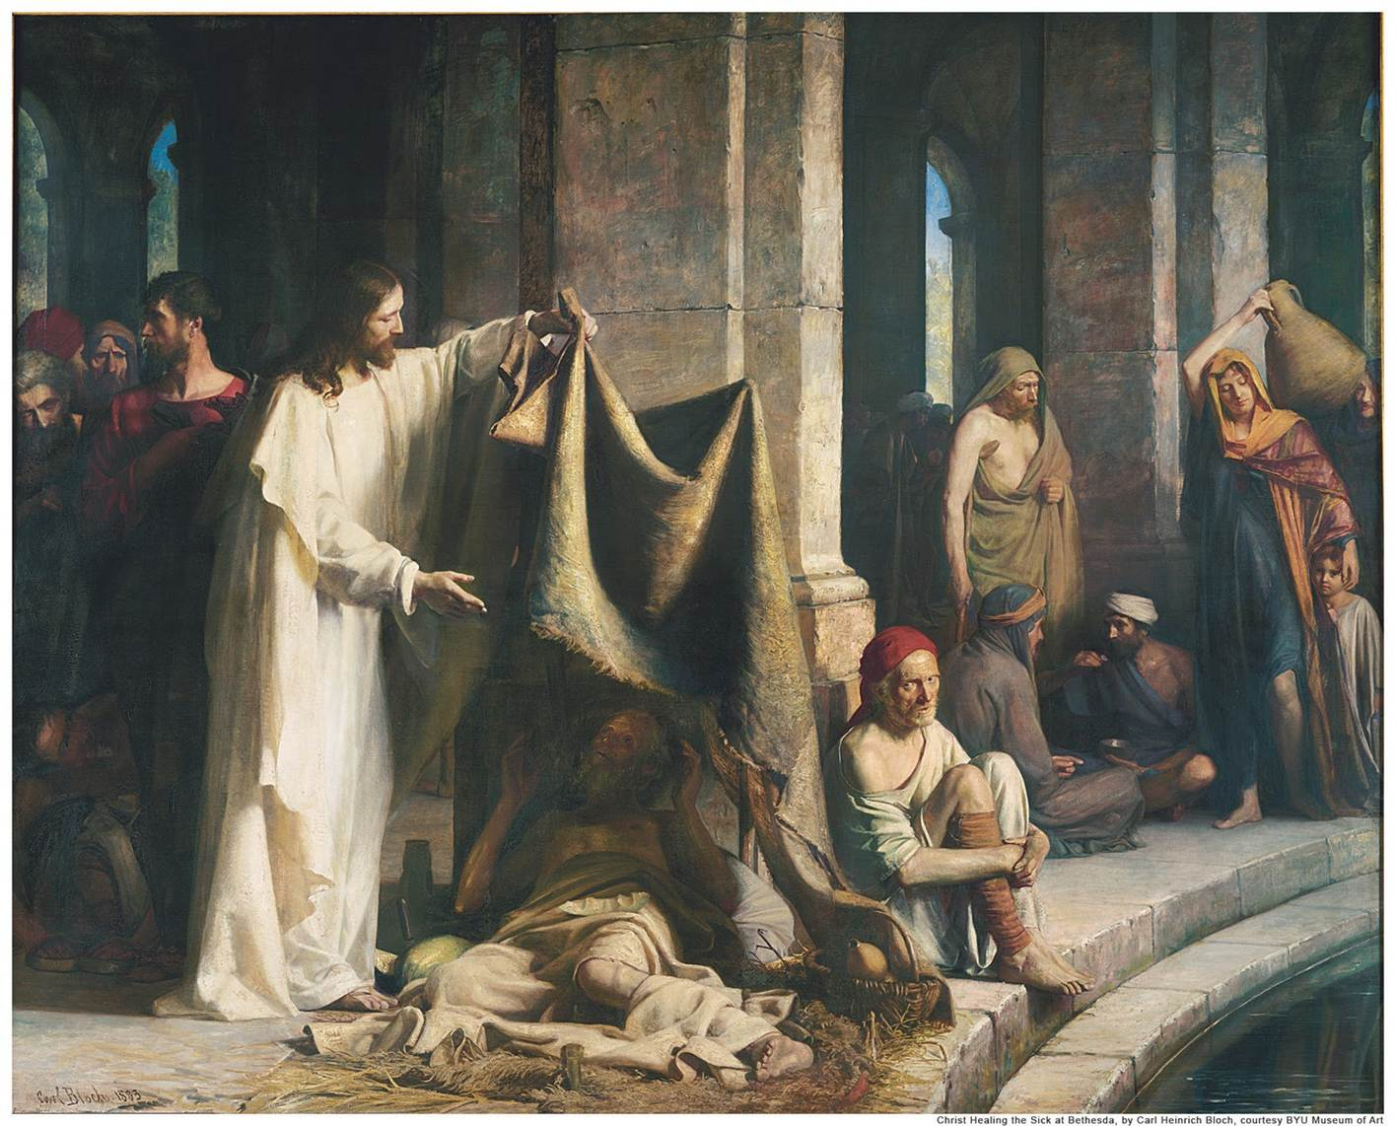
Jesus Healing the Sick at Bethesda 요5:8

Slide 22
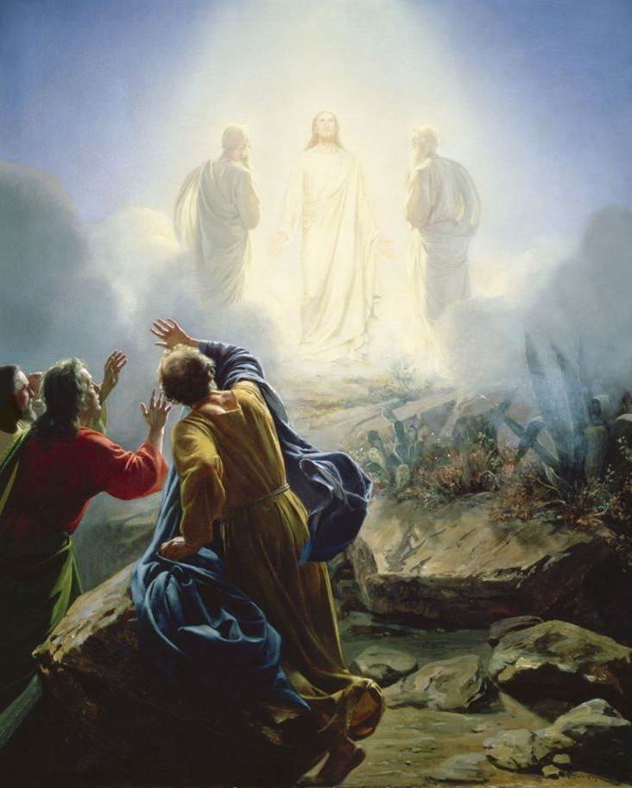
Transfiguration
마17:2

Slide 23
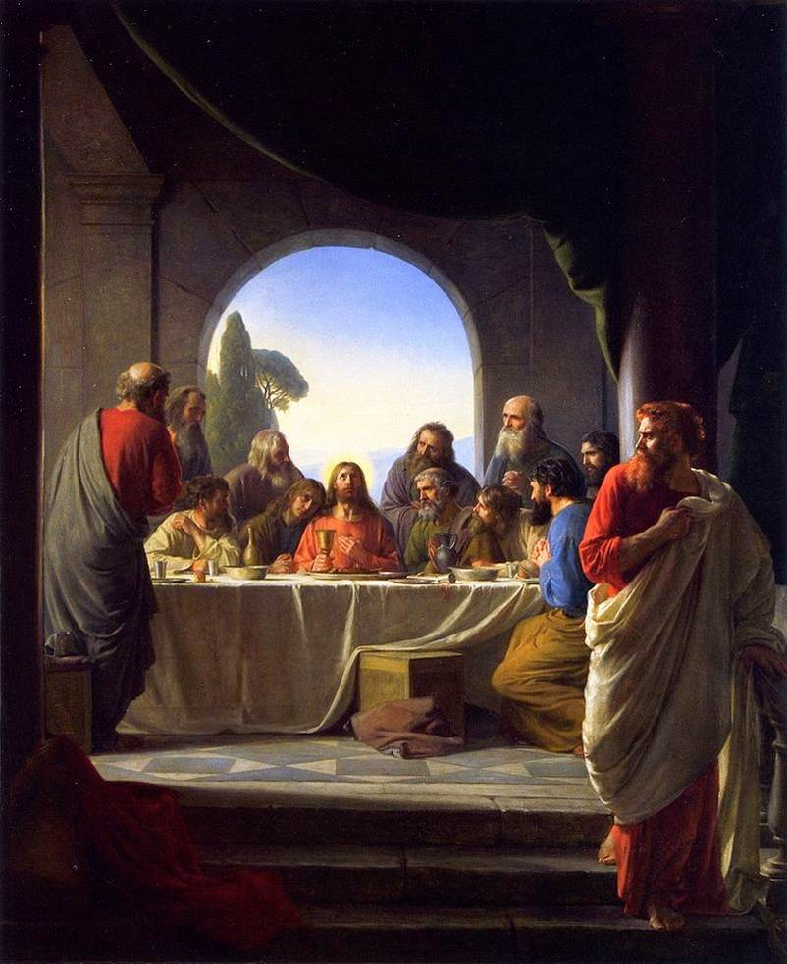
The Last Supper
마26:20

Slide 24
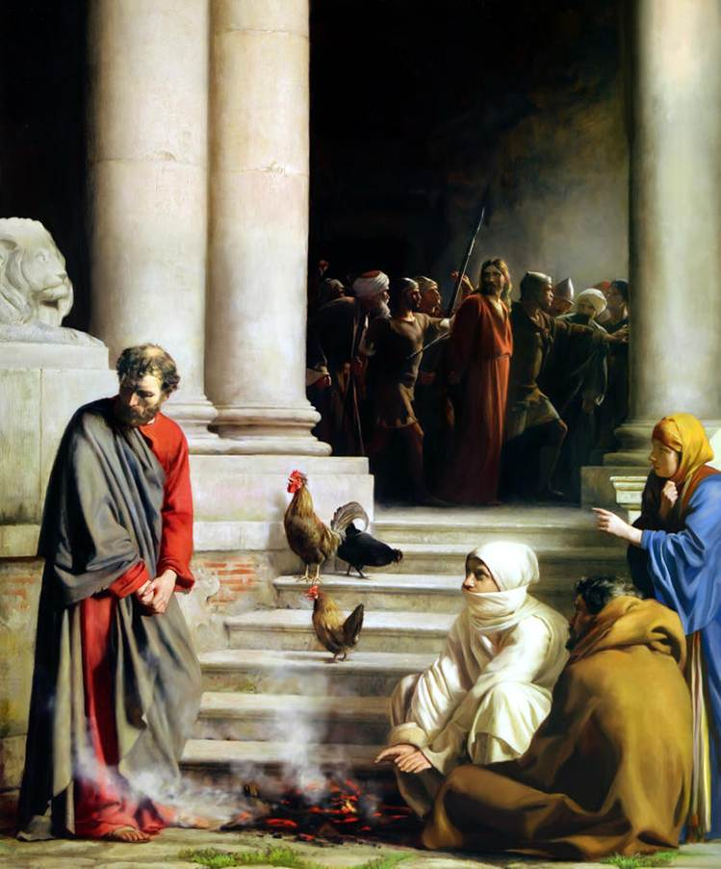
Peters Denial
마26:69

Slide 25
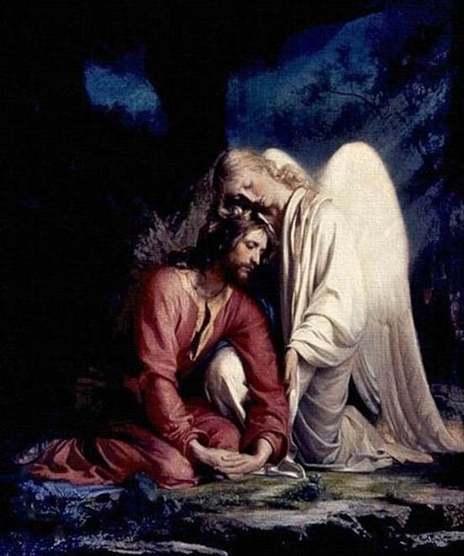
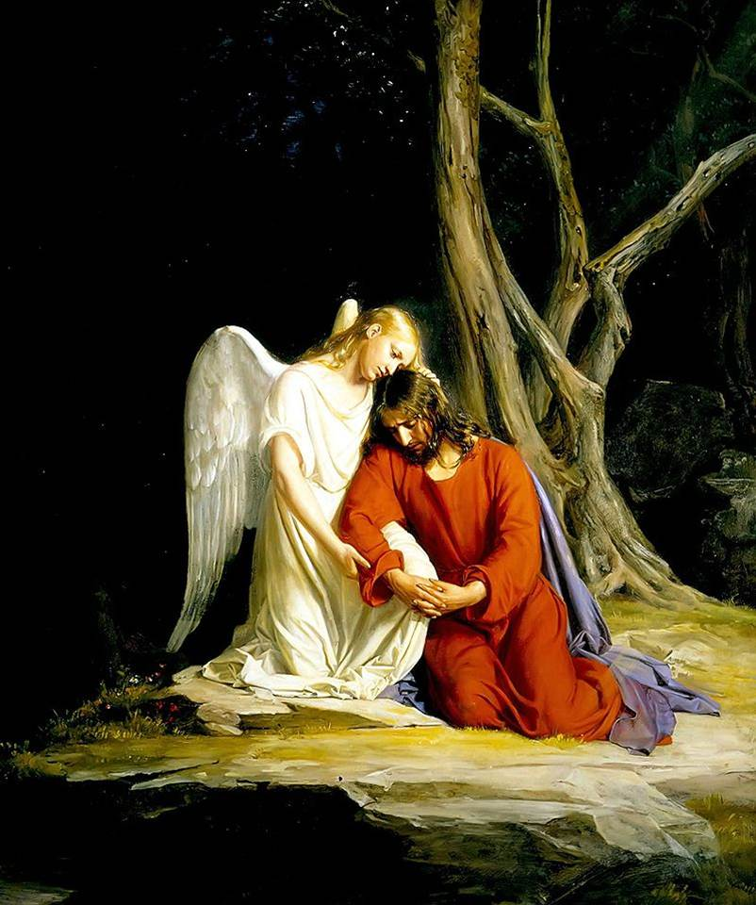
Gethsemane 마26:36

Slide 26
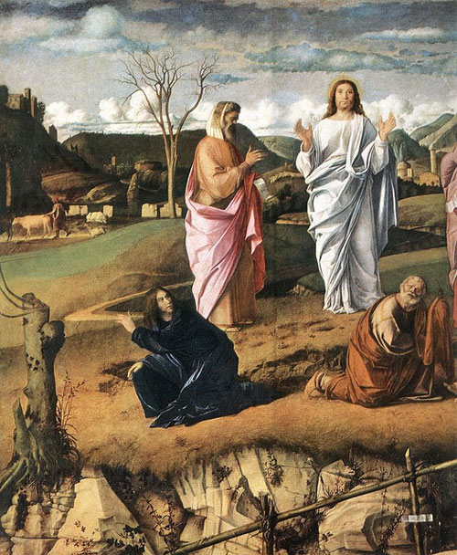
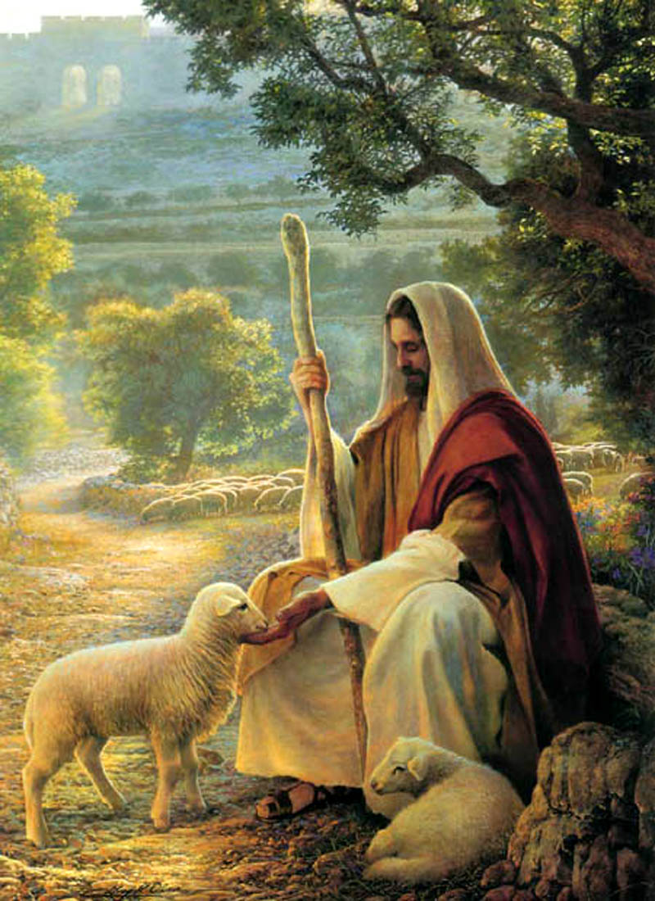
Agony in the Garden 마26:39
Notes:
The Charitable Lord Agony in the Garden 마26:39

Slide 27
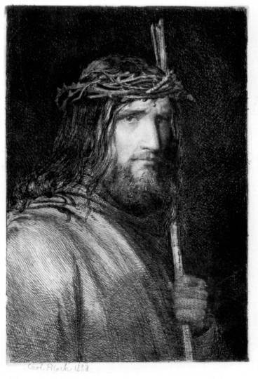
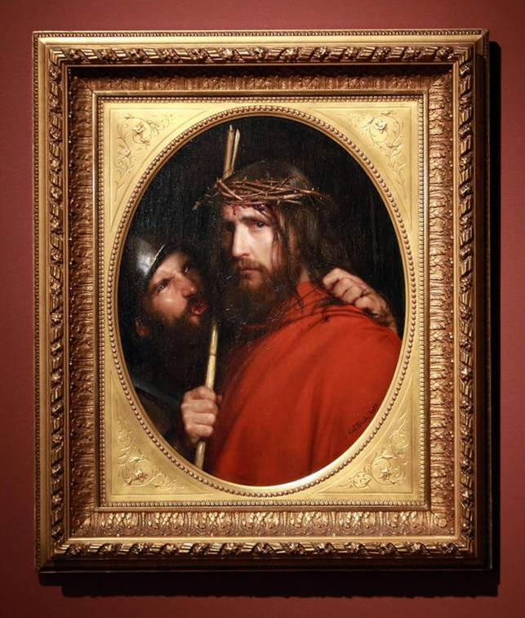
The Mocking of Christ 막15:17

Slide 28
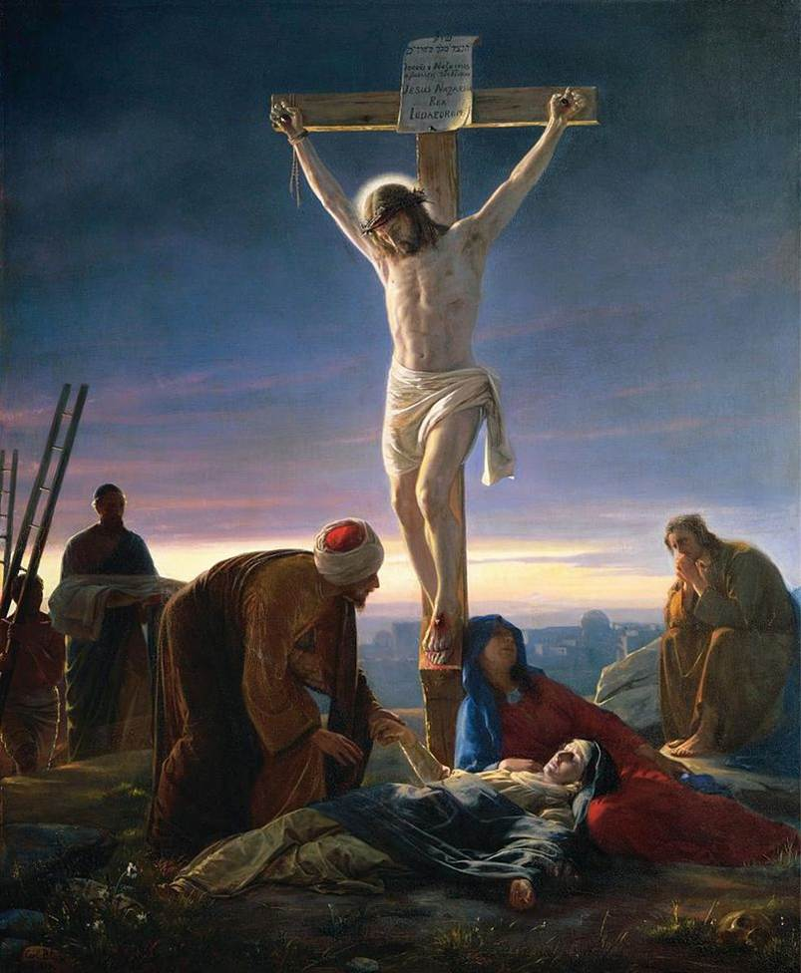
Christ at the Cross
막15:27

Slide 29
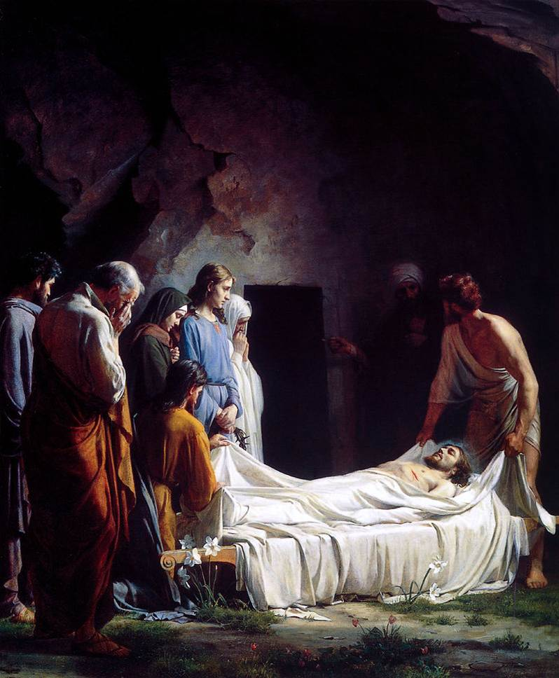
Burial of Christ
마27:50

Slide 30
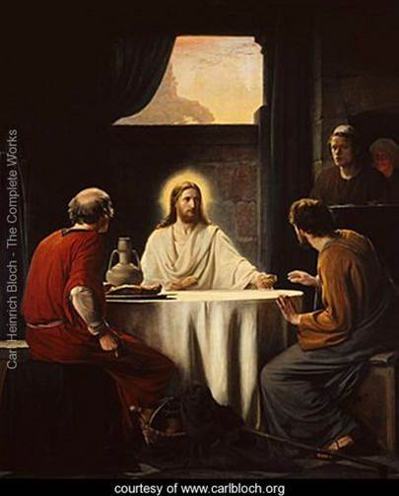
Supper at Emmaus
눅24:31

Slide 31
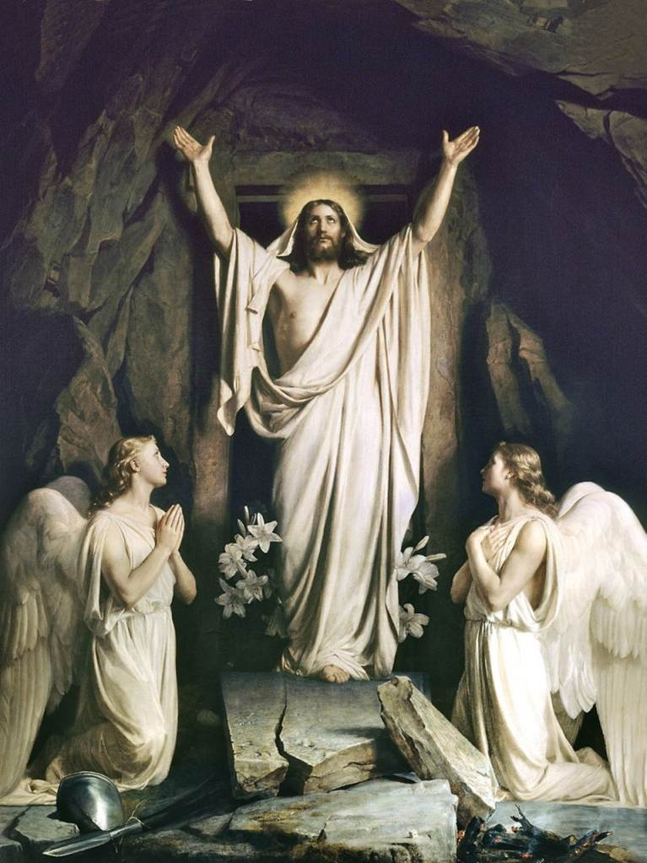
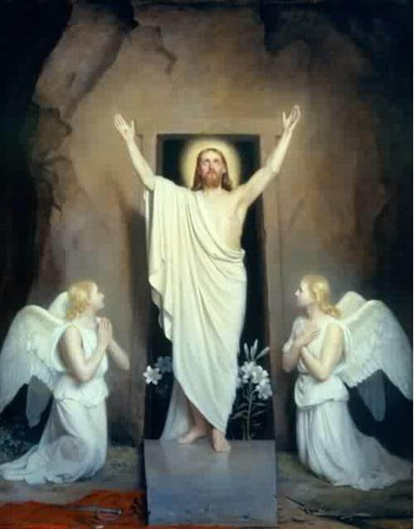
The Resurrection 마28:2

Slide 32
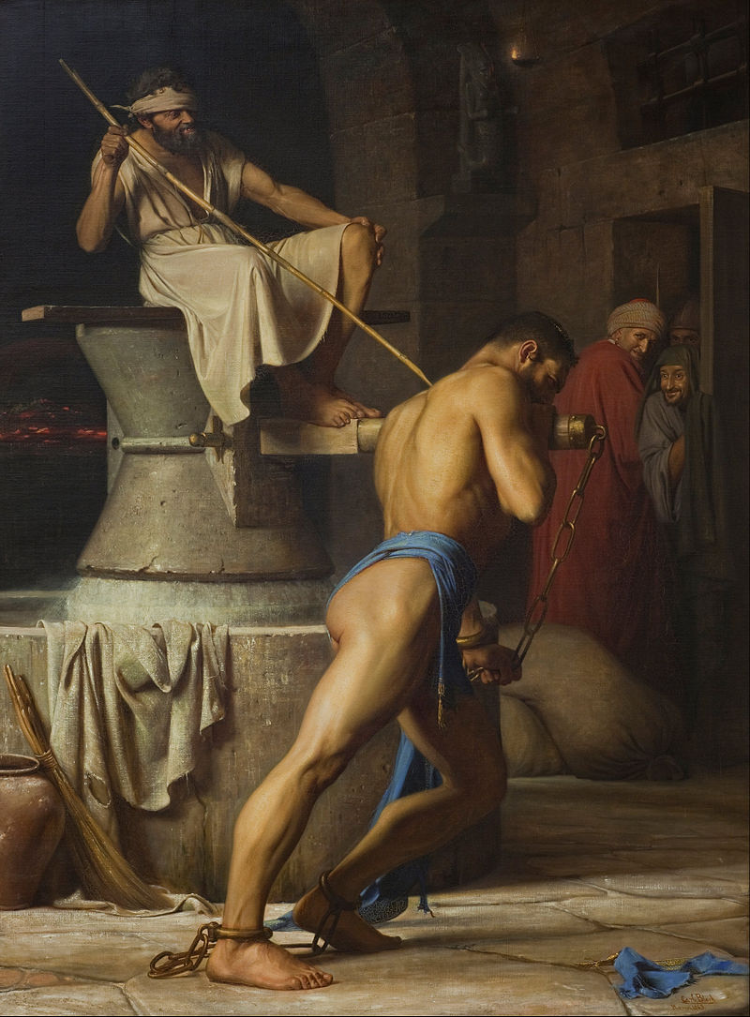
Samson and the Philistines
삿 16

Slide 33
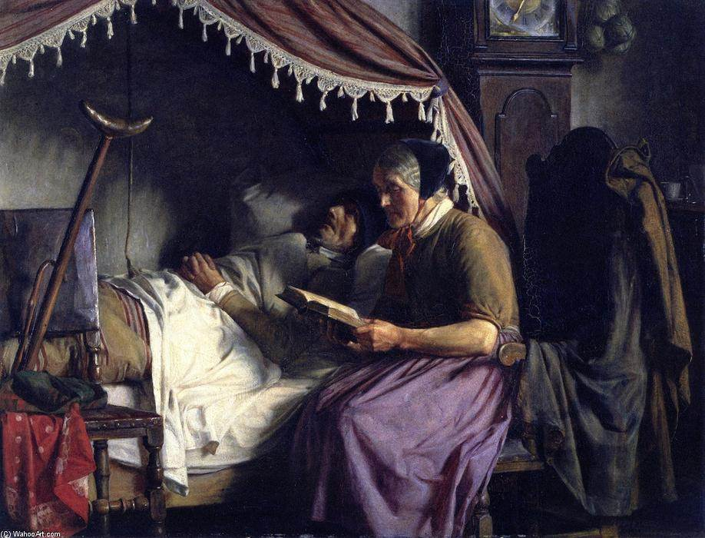

Slide 34
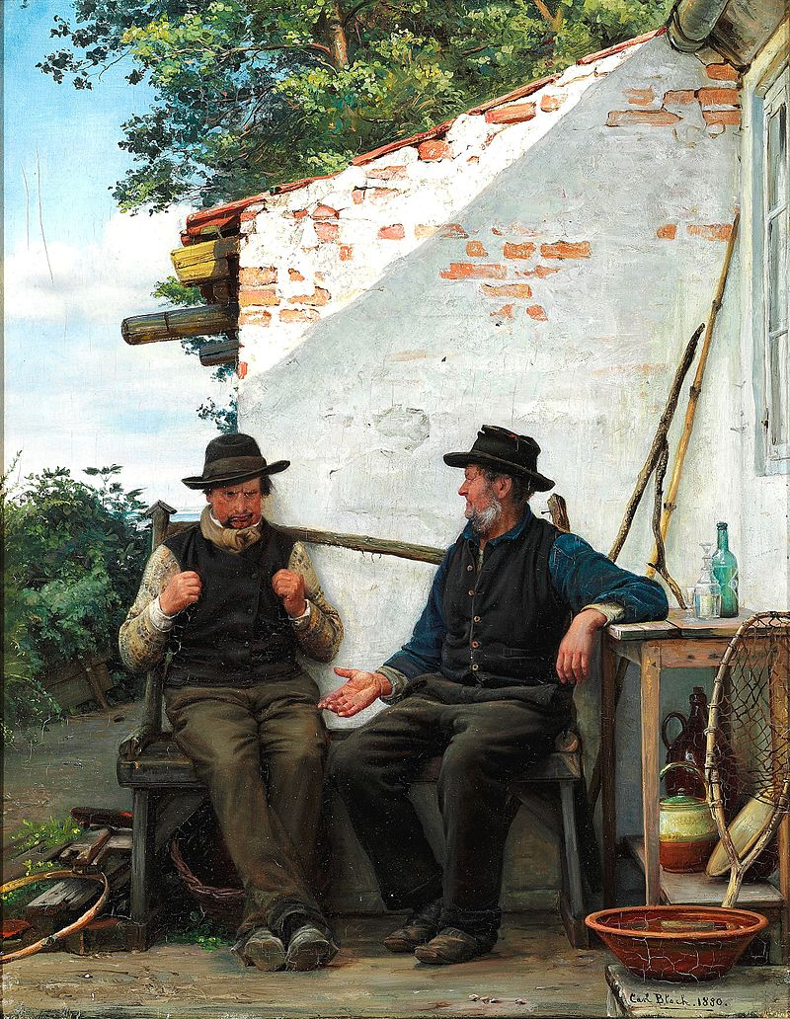
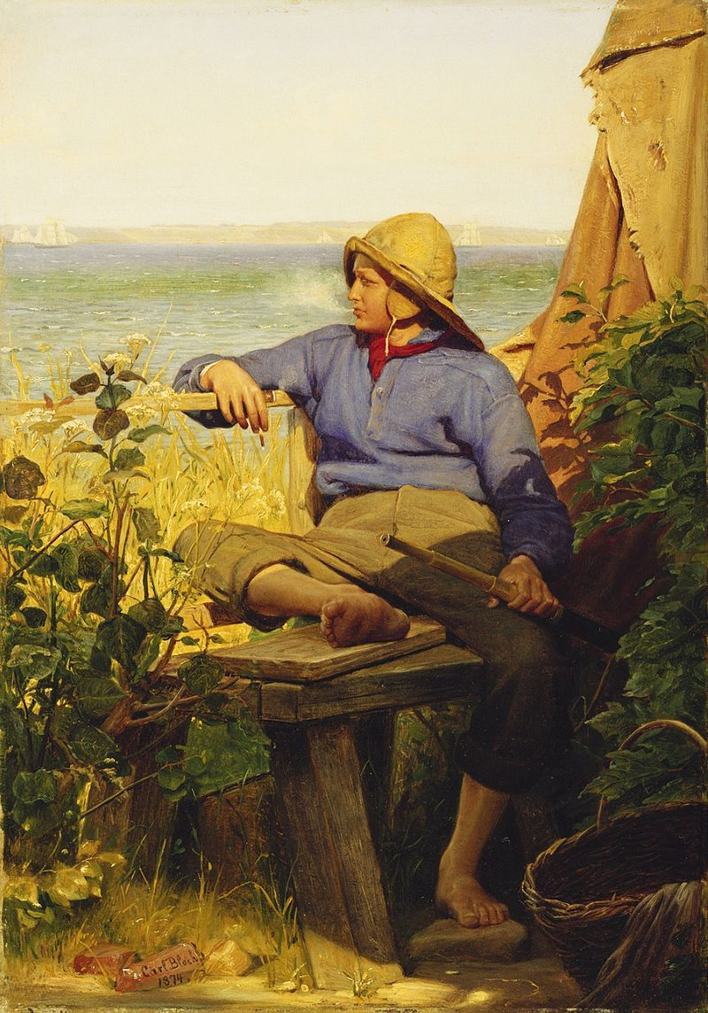

Slide 35
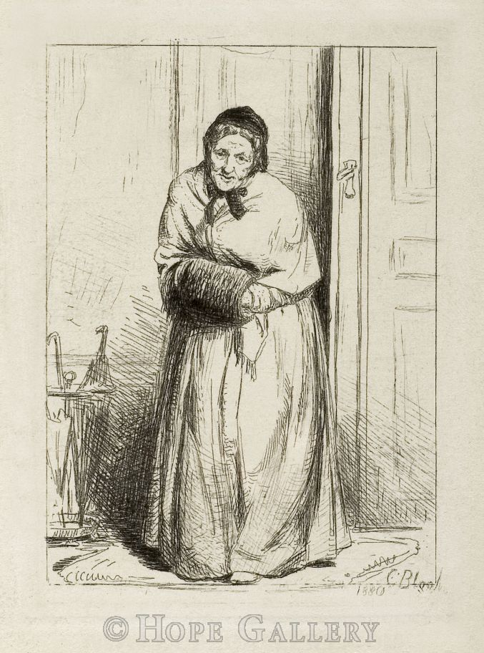
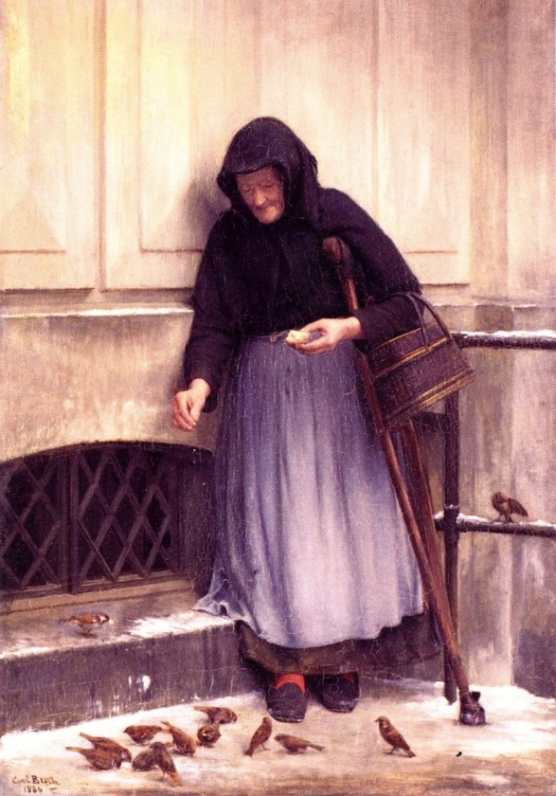

Slide 36
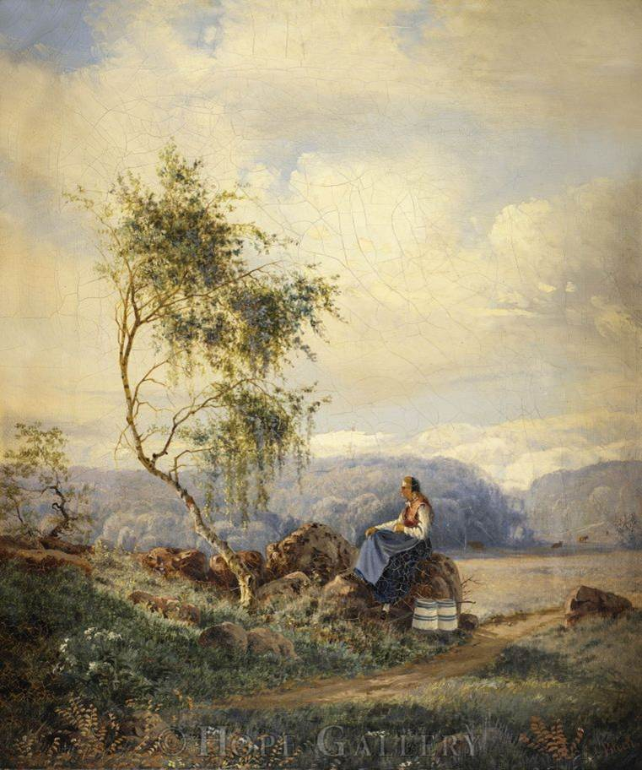
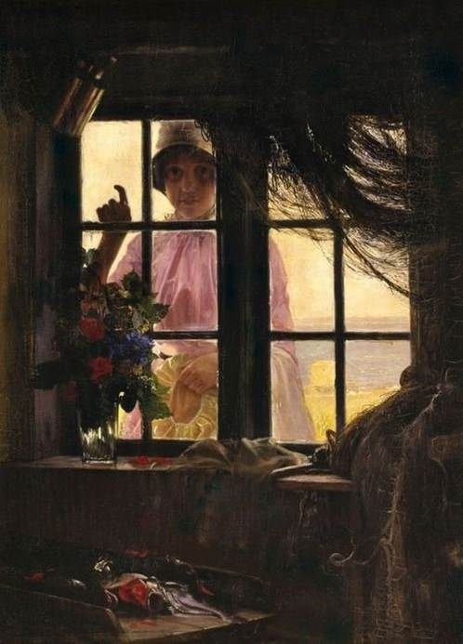

Slide 37
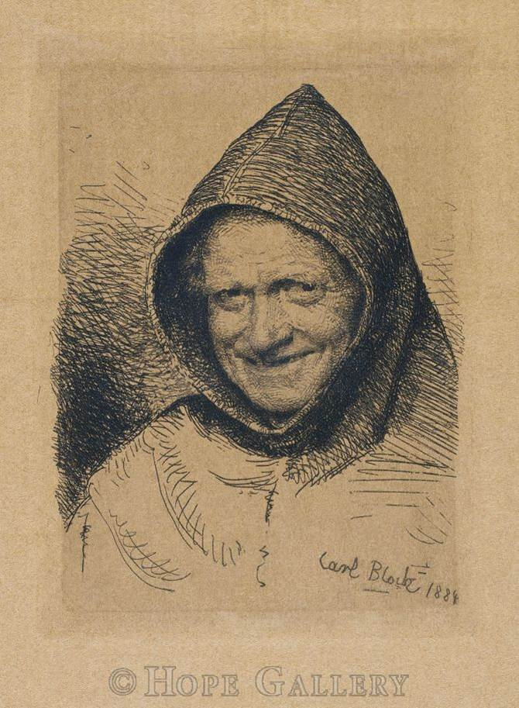
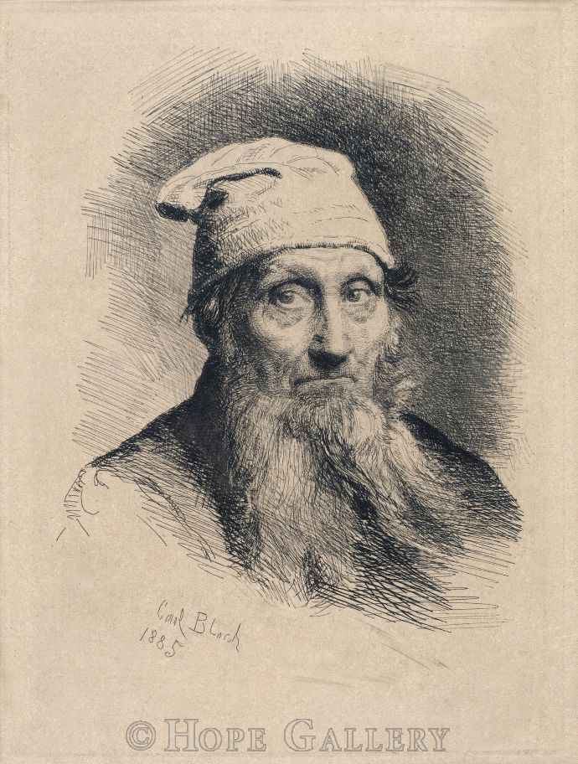
END

